Slide 1
P1 – PRODUCT

Slide 2
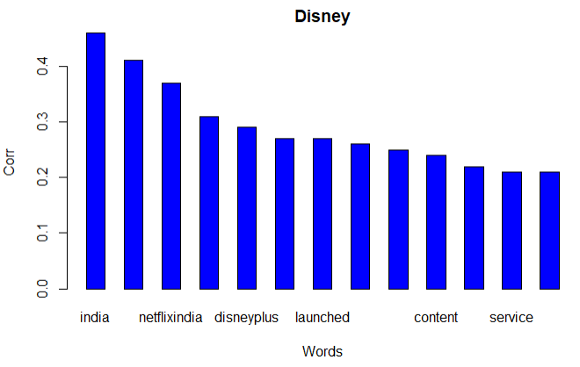
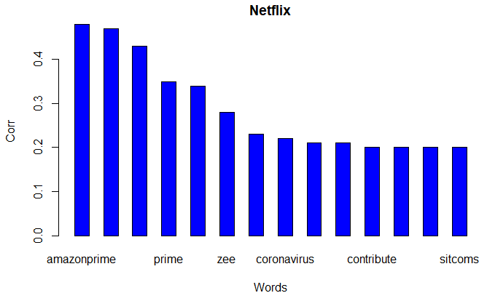
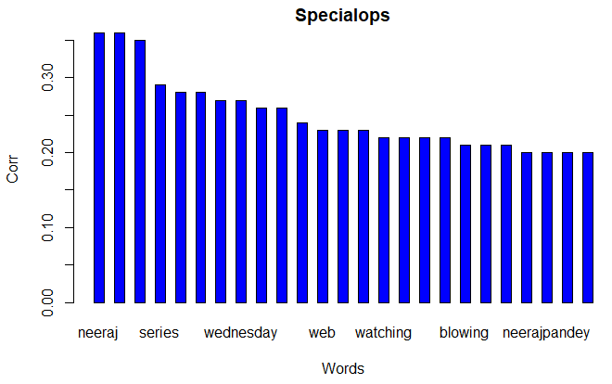
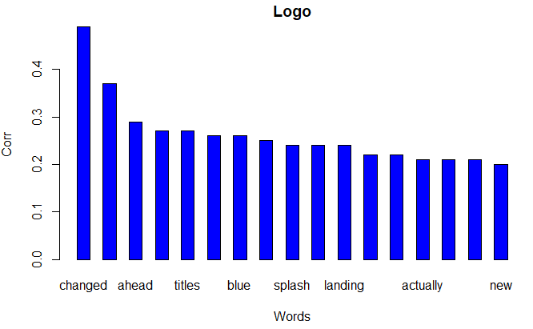
CORRELATION MATRIx FOR KEYWORDS RELATED TO PRODUCT

Slide 3
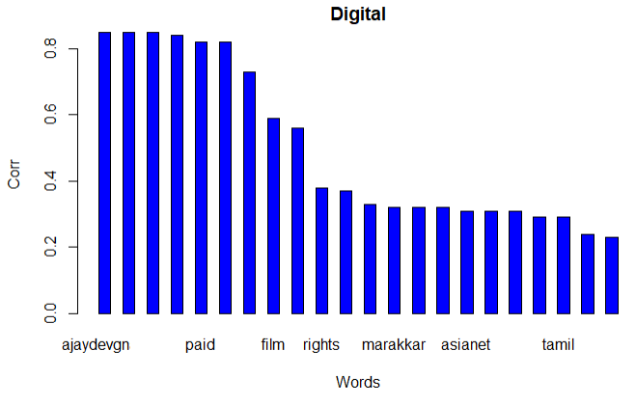
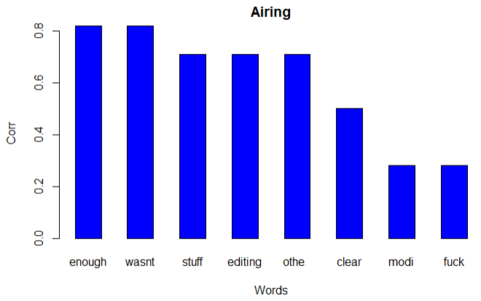
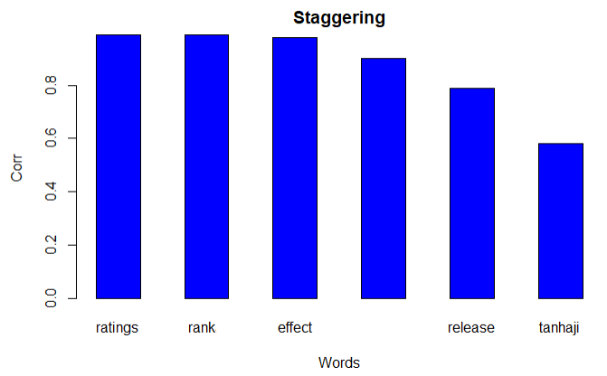
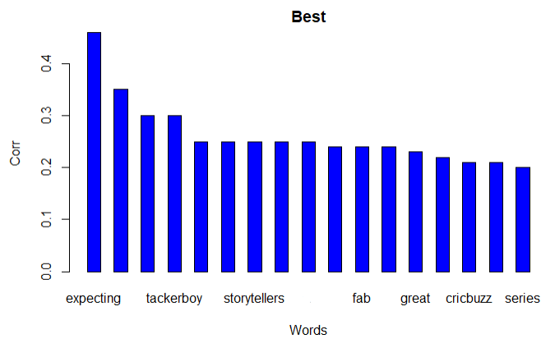
CORRELATION MATRIx FOR KEYWORDS RELATED TO PRODUCT

Slide 4
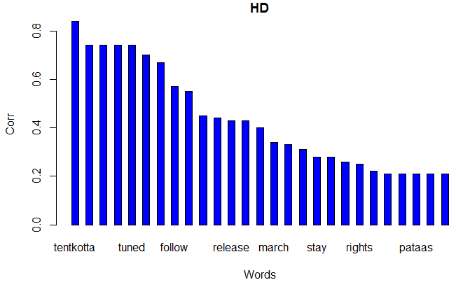
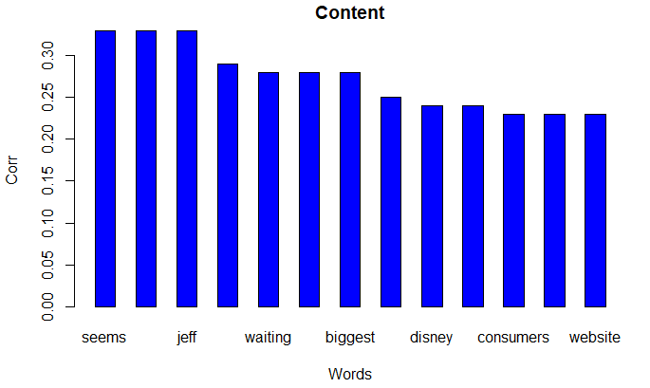
CORRELATION MATRIx FOR KEYWORDS RELATED TO PRODUCT

Slide 5
KEYWORDS USED
Disney – India, Amazonprime, Netflix, Launch, App, Marvel, Service, Pixar…
Netflix – Amazonprime, Zee, Home, Coronavirus, Socialdistancing, Contribute…
Specialops – Neeraj Pandey, KayKay Menon, Strongly, Recommend, Brilliant…
Logo – Changed, Intermediate, Ahead, Launch, Titles, Disneyplus, Android…
HD – Tentkotta, Drapupathi, Tuned, Psycho, Movies, Release, Tamil, March…
Content – Seems, Jeff Glodblum, Waiting, Biggest, Surprising, Consumers…
Digital – Ajay Devgn, Record, Highest, Paid, Distribution, Satellite, Rights…
Airing – Enough, Wasn’t, Stuff, Editing, Clear, Modi, Fuck
Staggering – Ratings, Rank, Effect, Tanhaji, Release
Best – Expecting, Work, AgentFarooqAli, Tackerboy, Specialops, Worldcup…

Slide 6
Marketing INSIGHTS
People generally very excited for the launch of Disneyplus in India through Hotstar (Scheduled on 29th) on 11th itself
But that sentiment immediately faded on the 12th and 13th when the content was removed and was labelled to be for testing. Customers disgruntled with the changes → Inform customers before any change and make them aware
Consumers more disappointed that launch on 29th has postponed due to corona as this is the time people have at their homes to watch
Consumers are addressing tweets at amazonprime, netflix and hotstar to make everything free until coronavirus goes down, so that people stay indoors
Consumers are requesting for a "Skip Song" feature in Indian movies - similar to the "Skip Intro" button

Slide 7
Marketing INSIGHTS
People felt cheated when an episode of Last week Tonight criticizing Modi was not shown, and other episodes were edited. Since this is paid content, people dont want hotstar to decide what they can see!
Attention to sports content was high due to the womens world cup, but died down as all sports matches are cancelled due to corona
Tanhaji the Unsung warrior had a hige affect on Hotstar's ratings / rank and they moved it. This was retweeted 75 times! → Hotstar must have many more superhit movies coming into the platform, to ensure viewer happiness!
The movie was on the streaming platform just 1.5 months post release, which means viewers want movies soon!
Hotstar spent a lot of money to acquire Tanhaji - 4th highest ever paid bollywood film to stream, and got the rewards → Invest in procuring the right movies

Slide 8
Marketing INSIGHTS
Overall sentiment of anticipation - people expecting more from hotstar due to specialops (calling it the "best" tv show)
Specialops – Many people watching now - Viewership also increased due to the increased homestay owing to coronavirus. Maybe the time period of release also helped - showing the nation as one and what it's doing
Most trending TV show in the selected period. People found it awesome, mind blowing etc. Referencing the actors as well as other hindi web series which have been good recently
Other quoted tv shows are outside the traditional genres - Customers liking those kind of stories more?

